Slide 1
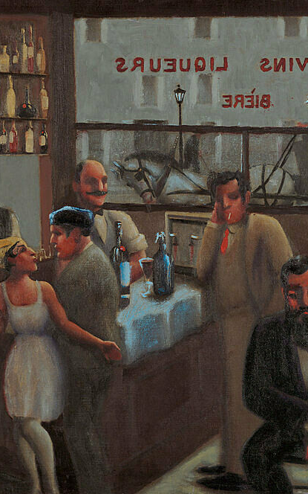
Banjo
Claude McKay

Slide 2
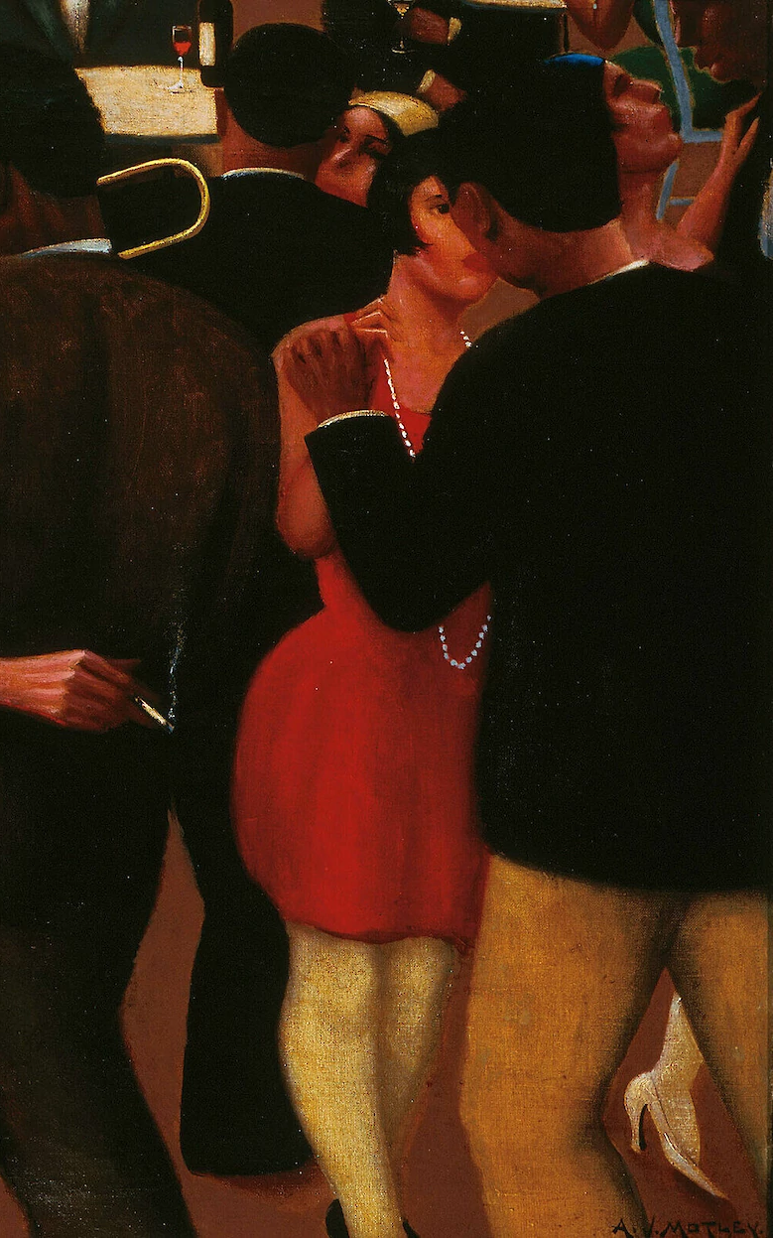
The Walls of Jericho
Rudolph Fisher

Slide 3
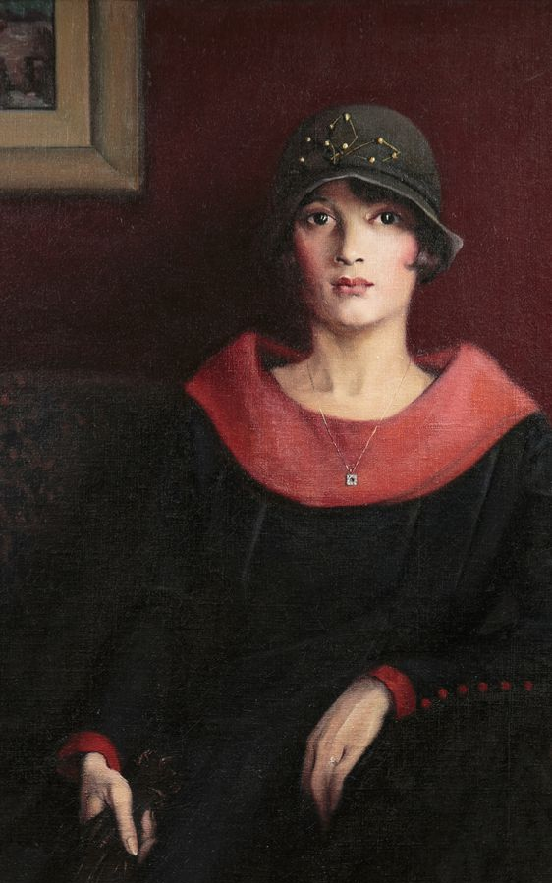
Passing Nella Larsen

Slide 4
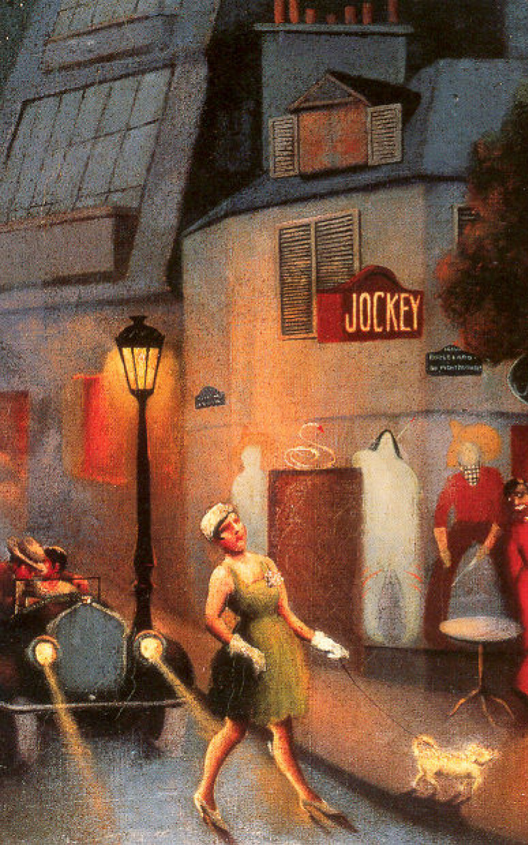
Plum Bun Jessie Redmon Fauset

Slide 5
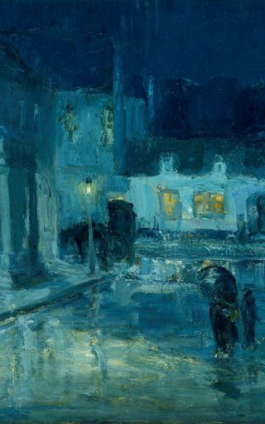
Flight Walter White

Slide 6
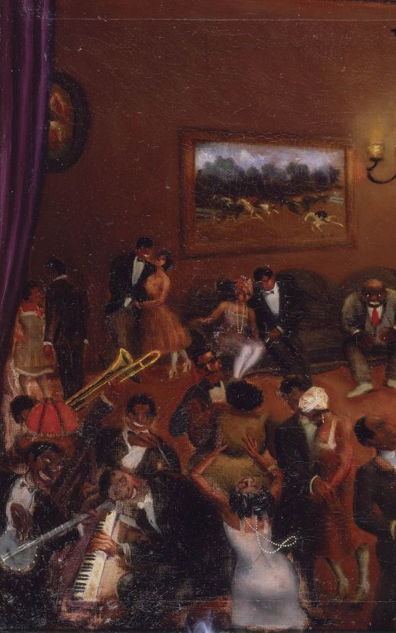
The Blacker the Berry Wallace Thurman

Slide 7
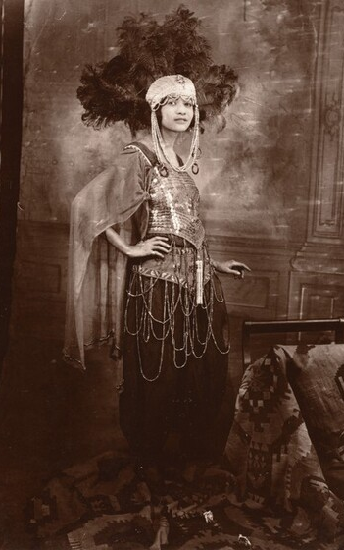
Dark Princess W.E.B Du Bois

Slide 8
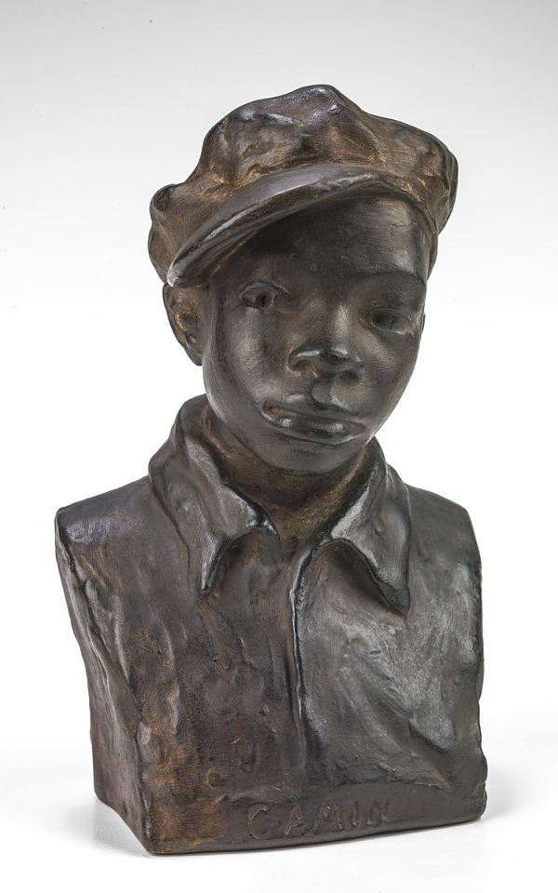
Home to Harlem
Claude McKay

Slide 9
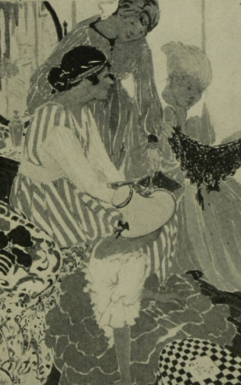
Quicksand
Nella Larsen

